Slide 1
Strategies for Improved Volunteer Engagement
17 January 2024
11:00 – 13:00 CET
TAFISA's Mission 2030 workshop

Slide 2
Connecting
Sport Volunteers with Organisations
The House of Sport Volunteers is a global initiative that connects skilled volunteers with receiving organisations, such as sport organisations, event organizers, NGOs, foundations, and other strategic partners from sport and beyond.
The House facilitates the participation of volunteers in sporting events of any size and sport-based projects, provides a global database of Sport Volunteers’ profiles, volunteering opportunities, and a unique offer of training, educational programmes, and certification of skills and competencies.

Slide 3
Benefits for Volunteers
Access to sport volunteering opportunities (next door and internationally)
Develop life skills and new competencies, and gain working experience
Certify skills and experiences
Access to educational programmes, training, and mentoring
Connect with a multinational network of like-minded people
Benefits for Organisations
Make available your training programmes and resources on sport volunteerism
Advertise your Sport Volunteer opportunities from grassroots to major sporting events
Gain access to a unique network of skilled and internationally trained volunteers
Actively contribute to the development of policies for the benefit of Sport Volunteers and sport at large

Slide 4
How to join the House as Member Organisations​
Who can join the House?
The House encourages the official involvement of stakeholders from the Business Sector willing to create benefits in support of the deployment of Sport Volunteers.
If your organisation would like to join The House, please send an email to: admin@houseofvolunteers.com.
Non-governmental and civil society organisations | Universities
Youth and volunteers' associations or networks | Cities
Sport clubs | Sport federations
Local organizing committees | International organisations
Public bodies

Slide 5
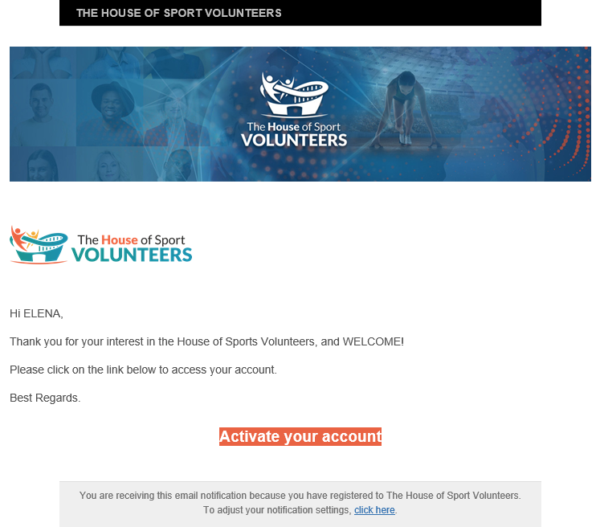
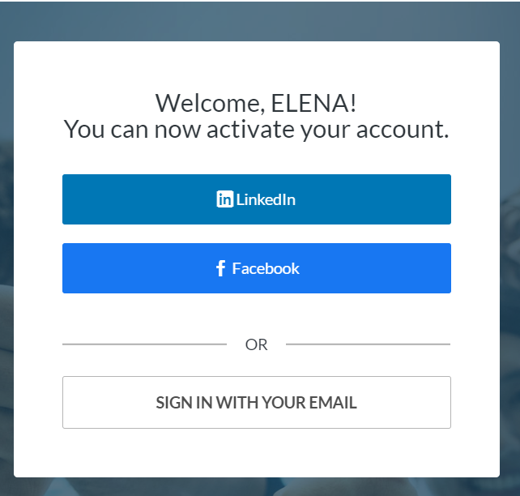
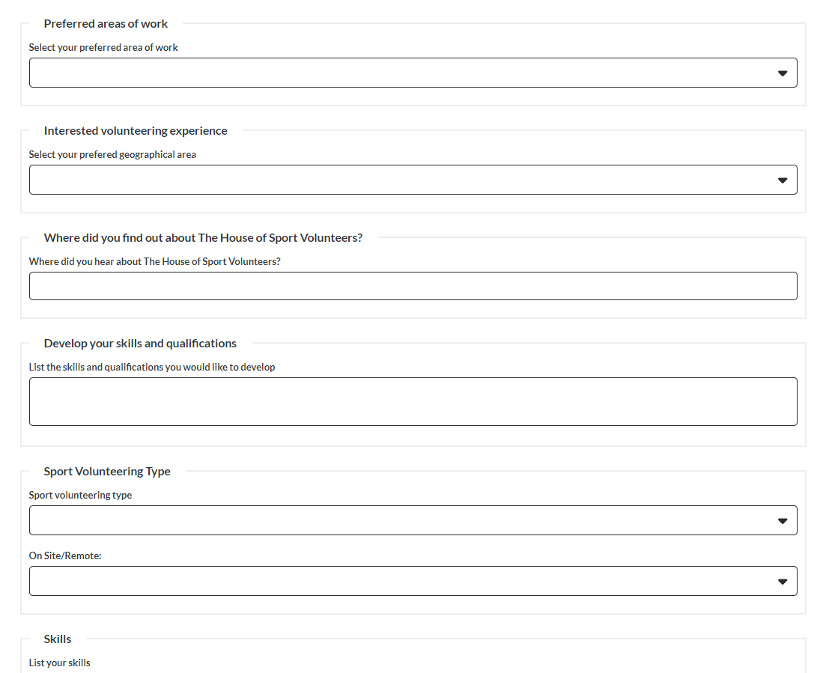
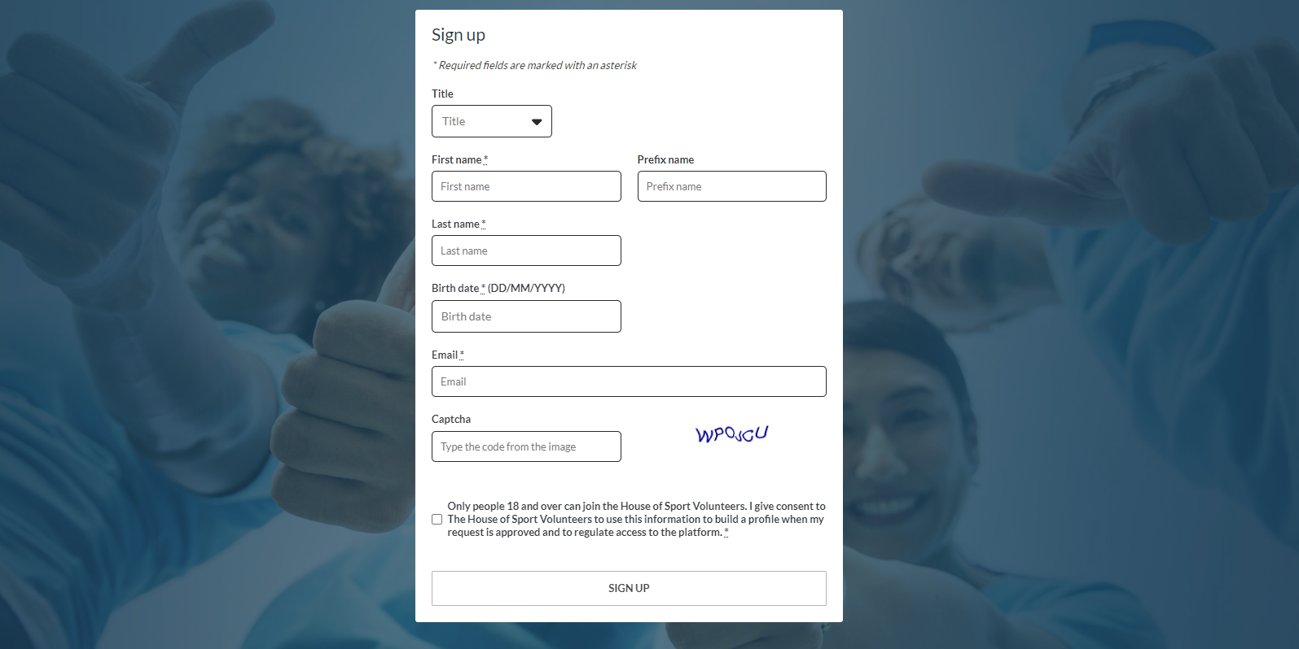
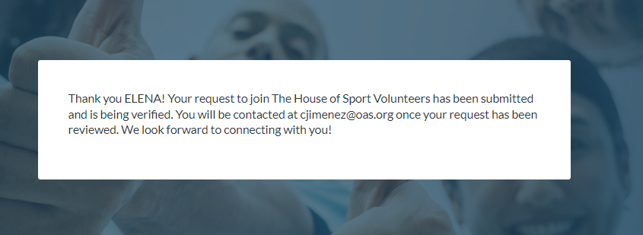
How to join the House as a Sport Volunteer?
1. Sign up
2. Activate your account
3. Sign with your email
4. Complete your profile

Slide 6
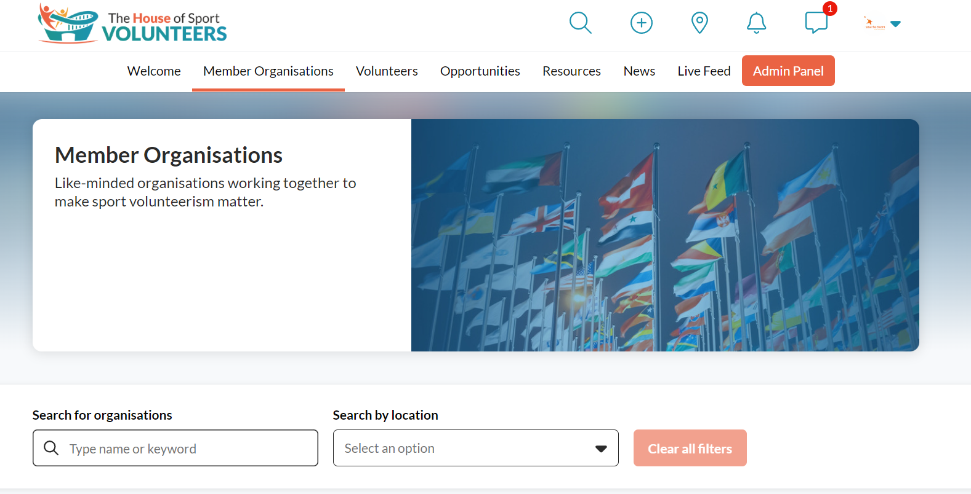
1. Expression of Interest
2. Review by the working group
3. Insert the Organisation's profile

Slide 7
Insights into volunteer challenges and
Strategies for improving engagement

Slide 8

​
Centralised roster of sport volunteers and opportunities at the grassroots and major events level, as well as SDP projects

Slide 9
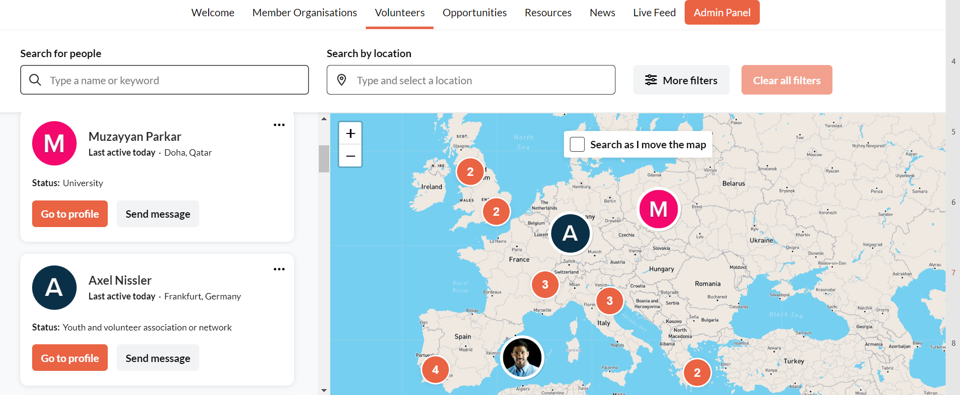

Slide 10
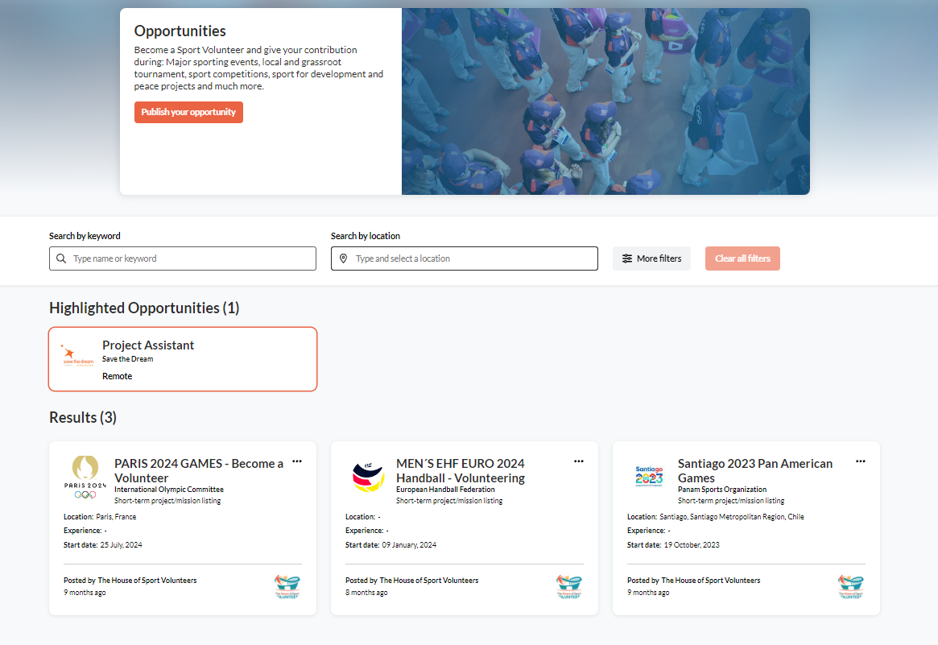

Slide 11

​
Support the development of Sport Volunteers' skills and competencies
Support Member Organisations to train their workforce

Slide 12

​
Development and Compilation of Policy Recommendations

Slide 13
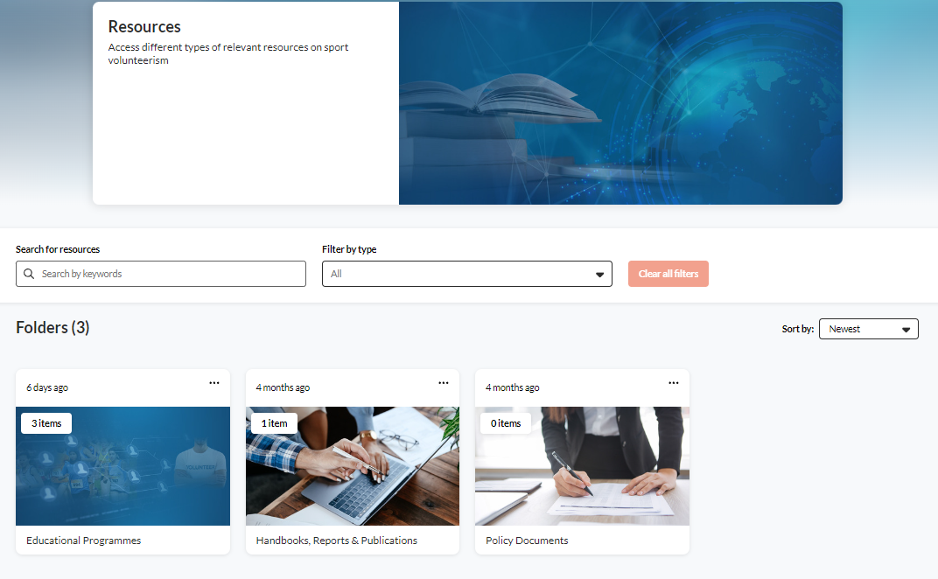
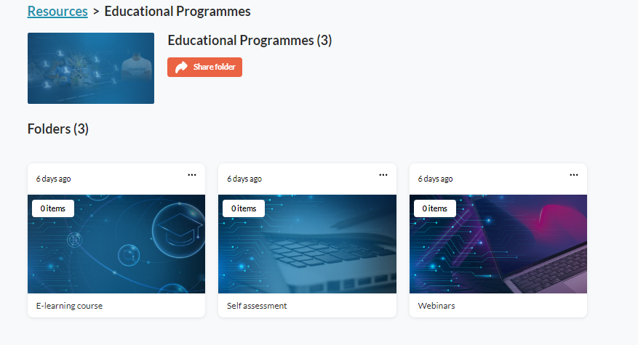

Slide 14


​
Certification of skills and competencies
​
Development of incentives (business sector, universities, municipalities, etc)

Slide 15

​
Promote the exchange of information among peers

Slide 16

Stay connected with our Member Organisations
Extend your volunteering network
Share your stories
Explore content of your interest

Slide 17

Thank you for your interest!!
For any questions, please contact us at:
admin@houseofvolunteers.com
If your organisation would like to join The House, please send an email to: admin@houseofvolunteers.com.​
www.houseofvolunteers.com

